Slide 1
Algorithms and Data Structures
Lecture IX
Simonas Šaltenis
Nykredit Center for Database Research
Aalborg University
simas@cs.auc.dk

Slide 2
This Lecture
Disk based data structures and algorithms
Principles
B-trees
Database Indices, Access methods

Slide 3
Disk Based Data Structures
So far search trees were limited to main memory structures
  Assumption: the dataset organized in a search tree fits in main memory (including the tree overhead)
Counter-example: transaction data of a bank > 1 GB per day
  use secondary storage media (punch cards, hard disks, magnetic tapes, etc.)
Consequence: make a search tree structure secondary-storage-enabled

Slide 4
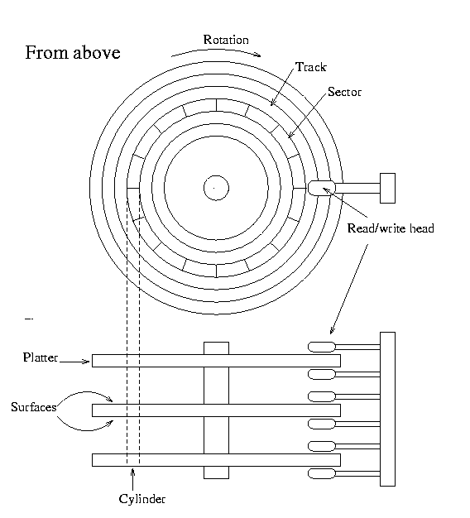
Hard Disks
Large amounts of storage, but slow access!
Identifying a page takes a long time (seek time plus rotational delay – 5-10ms), reading it is fast
  It pays off to read or write data in pages (or blocks) of 2-16 Kb in size.

Slide 5
Algorithm analysis
The running time of disk-based algorithms is measured in terms of
  computing time (CPU)
  number of disk accesses
    sequential reads
    random reads
Regular main-memory algorithms that work one data element at a time can not be “ported” to secondary storage in a straight-forward way

Slide 6
Principles
Pointers in data structures are no longer addresses in main memory but locations in files
If x is a pointer to an object
  if x is in main memory key[x] refers to it
  otherwise DiskRead(x) reads the object from disk into main memory (DiskWrite(x) – writes it back to disk)

Slide 7
Principles (2)
A typical working pattern
Operations:
  DiskRead(x:pointer_to_a_node)
  DiskWrite(x:pointer_to_a_node)
  AllocateNode():pointer_to_a_node
01 …
02 x ← a pointer to some object
03 DiskRead(x)
04 operations that access and/or modify x
05 DiskWrite(x) //omitted if nothing changed
06 other operations, only access no modify
07 …

Slide 8
Binary-trees vs. B-trees
Size of B-tree nodes is determined by the page size. One page – one node.
A B-tree of height 2 may contain > 1 billion keys!
Heights of Binary-tree and B-tree are logarithmic
  B-tree: logarithm of base, e.g., 1000
  Binary-tree: logarithm of base 2
1 node
1000 keys
1000
1001
1001 nodes,
1,001,000 keys
1000
1000
…
1000
1001
1001
1001
1,002,001 nodes,
1,002,001,000 keys
1000
1000
…
1000

Slide 9
B-tree Definitions
Node x has fields
  n[x]: the number of keys of that the node
  key₁[x] ≤ … ≤ key_{n[x]}[x]: the keys in ascending order
  leaf[x]: true if leaf node, false if internal node
  if internal node, then c₁[x], …, c_{n[x]+1}[x]: pointers to children
Keys separate the ranges of keys in the sub-trees. If k_{i} is an arbitrary key in the subtree c_{i}[x] then k_{i}≤ key_{i}[x] ≤ k_{i+1}

Slide 10
B-tree Definitions (2)
Every leaf has the same depth
In a B-tree of a degree t all nodes except the root node have between t and 2t children (i.e., between t–1 and 2t–1 keys).
The root node has between 0 and 2t children (i.e., between 0 and 2t–1 keys)

Slide 11
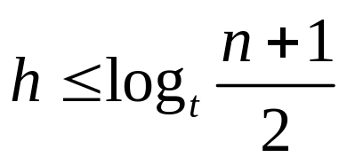
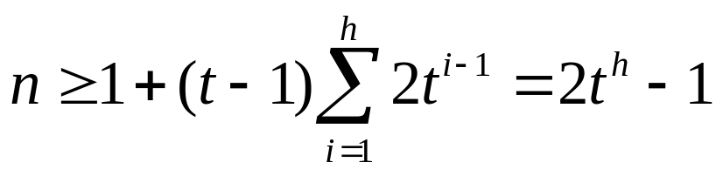
Height of a B-tree
B-tree T of height h, containing n ≥ 1 keys and minimum degree t ≥ 2, the following restriction on the height holds:
depth | #of nodes
1
0 | 1
1 | 2
2 | 2t
t - 1
t - 1
t
t
t - 1
t - 1
…
t - 1
t - 1
t - 1
…
t - 1

Slide 12
Red-Black-trees and B-trees
Comparing RB-trees and B-trees
  both have a height of O(log n)
  for RB-tree a height is O(log₂ n)
  for B-trees a height is O(log₁₀₀₀ n) (here t =1000)
The difference with respect to the height of the tree is lg t
When t=2, B-trees are 2-3-4-trees (which are representations of red-black trees)!

Slide 13
B-tree Operations
An implementation needs to suport the following B-tree operations
  Searching (simple)
  Creating an empty tree (trivial)
  Insertion (complex)
  Deletion (complex)

Slide 14
Searching
Straightforward generalization of a binary tree search
BTreeSearch(x,k)
01 i ← 1
02 while i ≤ n[x] and k > key_{i}[x]
03 i ← i+1
04 if i ≤ n[x] and k = key_{i}[x] then
05 return(x,i)
06 if leaf[x] then
08 return NIL
09 else DiskRead(c_{i}[x])
10 return BTtreeSearch(c_{i}[x],k)

Slide 15
Creating an Empty Tree
Empty B-tree = create a root & write it to disk!
BTreeCreate(T)
01 x ← AllocateNode();
02 leaf[x] ← TRUE;
03 n[x] ← 0;
04 DiskWrite(x);
05 root[T] ← x

Slide 16
Splitting Nodes
Nodes fill up and reach their maximum capacity 2t – 1
Before we can insert a new key, we have to “make room,” i.e., split nodes

Slide 17
Splitting Nodes (2)
Result: one key of x moves up to parent + 2 nodes with t-1 keys
key_{i}[x]
key_{i-1}[x]
key_{i}[x]
key_{i-1}[x]
key_{i+1}[x]
x
x
... N W ...
... N S W ...
y = c_{i}[x]
y = c_{i}[x]
z = c_{i+1}[x]
P Q R S T V W
P Q R
T V W
T₁
...
T₈

Slide 18
Splitting Nodes (2)
BTreeSplitChild(x,i,y)
01 z ← AllocateNode()
02 leaf[z] ← leaf[y]
03 n[z] ← t-1
04 for j ← 1 to t-1
05 key_{j}[z] ← key_{j+t}[y]
06 if not leaf[y] then
07 for j ← 1 to t
08 c_{j}[z] ← c_{j+t}[y]
09 n[y] ← t-1
10 for j ← n[x]+1 downto i+1
11 c_{j+1}[x] ← c_{j}[x]
12 c_{i+1}[x] ← z
13 for j ← n[x] downto i
14 key_{j+1}[x] ← key_{j}[x]
15 key_{i}[x] ← key_{t}[y]
16 n[x] ← n[x]+1
17 DiskWrite(y)
18 DiskWrite(z)
19 DiskWrite(x)
x: parent node
y: node to be split and child of x
i: index in x
z: new node
key_{i}[x]
key_{i-1}[x]
x
... N W ...
y = c_{i}[x]
P Q R S T V W
T₁
...
T₈

Slide 19
Split: Running Time
A local operation that does not traverse the tree
Θ(t) CPU-time, since two loops run t times
3 I/Os

Slide 20
Inserting Keys
Done recursively, by starting from the root and recursively traversing down the tree to the leaf level
Before descending to a lower level in the tree, make sure that the node contains < 2t – 1 keys:
  so that if we split a node in a lower level we will have space to include a new key

Slide 21
Inserting Keys (2)
Special case: root is full (BtreeInsert)
BTreeInsert(T)
01 r ← root[T]
02 if n[r] = 2t – 1 then
03 s ← AllocateNode()
05 root[T] ← s
06 leaf[s] ← FALSE
07 n[s] ← 0
08 c₁[s] ← r
09 BTreeSplitChild(s,1,r)
10 BTreeInsertNonFull(s,k)
11 else BTreeInsertNonFull(r,k)

Slide 22
Splitting the Root
Splitting the root requires the creation of a new root
The tree grows at the top instead of the bottom
root[T]
root[T]
s
r
H
A D F H L N P
r
A D F
L N P
T₁
...
T₈

Slide 23
Inserting Keys
BtreeNonFull tries to insert a key k into a node x, which is assumed to be non-full when the procedure is called
BTreeInsert and the recursion in BTreeInsertNonFull guarantee that this assumption is true!

Slide 24
Inserting Keys: Pseudo Code
BTreeInsertNonFull(x,k)
01 i ← n[x]
02 if leaf[x] then
03 while i ≥ 1 and k < key_{i}[x]
04 key_{i+1}[x] ← key_{i}[x]
05 i ← i - 1
06 key_{i+1}[x] ← k
07 n[x] ← n[x] + 1
08 DiskWrite(x)
09 else while i ≥ 1 and k < key_{i}[x]
10 i ← i - 1
11 i ← i + 1
12 DiskRead c_{i}[x]
13 if n[c_{i}[x]] = 2t – 1 then
14 BTreeSplitChild(x,i,c_{i}[x])
15 if k > key_{i}[x] then
16 i ← i + 1
17 BTreeInsertNonFull(c_{i}[x],k)
leaf insertion
internal node: traversing tree

Slide 25
Insertion: Example
initial tree (t = 3)
G M P X
A C D E
J K
N O
R S T U V
Y Z
B inserted
G M P X
A B C D E
J K
N O
R S T U V
Y Z
Q inserted
G M P T X
A B C D E
J K
N O
Q R S
U V
Y Z

Slide 26
Insertion: Example (2)
L inserted
P
G M
T X
A B C D E
J K L
N O
Q R S
U V
Y Z
F inserted
P
C G M
T X
A B
D E F
J K L
N O
Q R S
U V
Y Z

Slide 27
Insertion: Running Time
Disk I/O: O(h), since only O(1) disk accesses are performed during recursive calls of BTreeInsertNonFull
CPU: O(th) = O(t log_{t}n)
At any given time there are O(1) number of disk pages in main memory

Slide 28
Deleting Keys
Done recursively, by starting from the root and recursively traversing down the tree to the leaf level
Before descending to a lower level in the tree, make sure that the node contains ≥ t keys (cf. insertion < 2t – 1 keys)
BtreeDelete distinguishes three different stages/scenarios for deletion
  Case 1: key k found in leaf node
  Case 2: key k found in internal node
  Case 3: key k suspected in lower level node

Slide 29
Deleting Keys (2)
initial tree
P
Case 1: If the key k is in node x, and x is a leaf, delete k from x
C G M
T X
A B
D E F
J K L
N O
Q R S
U V
Y Z
F deleted: case 1
P
C G M
T X
A B
D E
J K L
N O
Q R S
U V
Y Z
x

Slide 30
Deleting Keys (3)
Case 2: If the key k is in node x, and x is not a leaf, delete k from x
  a) If the child y that precedes k in node x has at least t keys, then find the predecessor k’ of k in the sub-tree rooted at y. Recursively delete k’, and replace k with k’ in x.
  b) Symmetrically for successor node z
M deleted: case 2a
P
C G L
x
T X
A B
D E
J K
N O
Q R S
U V
Y Z
y

Slide 31
Deleting Keys (4)
If both y and z have only t –1 keys, merge k with the contents of z into y, so that x loses both k and the pointers to z, and y now contains 2t – 1 keys. Free z and recursively delete k from y.
G deleted: case 2c
P
C L
x - k
T X
A B
D E J K
N O
Q R S
U V
Y Z
y = y+k + z - k

Slide 32
Deleting Keys - Distribution
Descending down the tree: if k not found in current node x, find the sub-tree c_{i}[x] that has to contain k.
If c_{i}[x] has only t – 1 keys take action to ensure that we descent to a node of size at least t.
We can encounter two cases.
  If c_{i}[x] has only t-1 keys, but a sibling with at least t keys, give c_{i}[x] an extra key by moving a key from x to c_{i}[x], moving a key from c_{i}[x]’s immediate left and right sibling up into x, and moving the appropriate child from the sibling into c_{i}[x] - distribution

Slide 33
Deleting Keys – Distribution(2)
x
... k ...
x
... k’ ...
c_{i}[x]
...
k’
c_{i}[x]
... k
A
B
A B
C L P T X
delete B
c_{i}[x]
A B
E J K
N O
Q R S
U V
Y Z
sibling
B deleted:
E L P T X
A C
J K
N O
Q R S
U V
Y Z

Slide 34
Deleting Keys - Merging
If c_{i}[x] and both of c_{i}[x]’s siblings have t – 1 keys, merge c_{i} with one sibling, which involves moving a key from x down into the new merged node to become the median key for that node
x
... l’ k m’...
x
... l’ m’ ...
c_{i}[x]
... l
m …
...l k m ...
A
B
A B

Slide 35
Deleting Keys – Merging (2)
P
delete D
c_{i}[x]
sibling
C L
T X
A B
D E J K
N O
Q R S
U V
Y Z
D deleted:
C L P T X
A B
E J K
N O
Q R S
U V
Y Z
tree shrinks in height

Slide 36
Deletion: Running Time
Most of the keys are in the leaf, thus deletion most often occurs there!
In this case deletion happens in one downward pass to the leaf level of the tree
Deletion from an internal node might require “backing up” (case 2)
Disk I/O: O(h), since only O(1) disk operations are produced during recursive calls
CPU: O(th) = O(t log_{t}n)

Slide 37
Two-pass Operations
Simpler, practical versions of algorithms use two passes (down and up the tree):
  Down – Find the node where deletion or insertion should occur
  Up – If needed, split, merge, or distribute; propagate splits, merges, or distributes up the tree
To avoid reading the same nodes twice, use a buffer of nodes

Slide 38
Other Access Methods
B-tree variants: B⁺-trees, B*-trees
B⁺-trees used in data base management systems
General Scheme for access methods (used in B⁺-trees, too):
  Data keys stored only in leaves
  Each entry in a non-leaf node stores
    a pointer to a sub-tree
    a compact description of the set of keys stored in this sub-tree

Slide 39
Dictionary ADT: Summary
Implementing the Dictionary ADT:
  If only Insert, Search (and Delete) are needed – hashing
  If Min, Max, Successor, Predecessor are needed – balanced binary trees (Red-Black trees or AVL-trees)
  If the data is on the secondary storage – B-trees

Slide 40
Next Week
Solving optimization problems using Dynamic Programming

